Slide 1
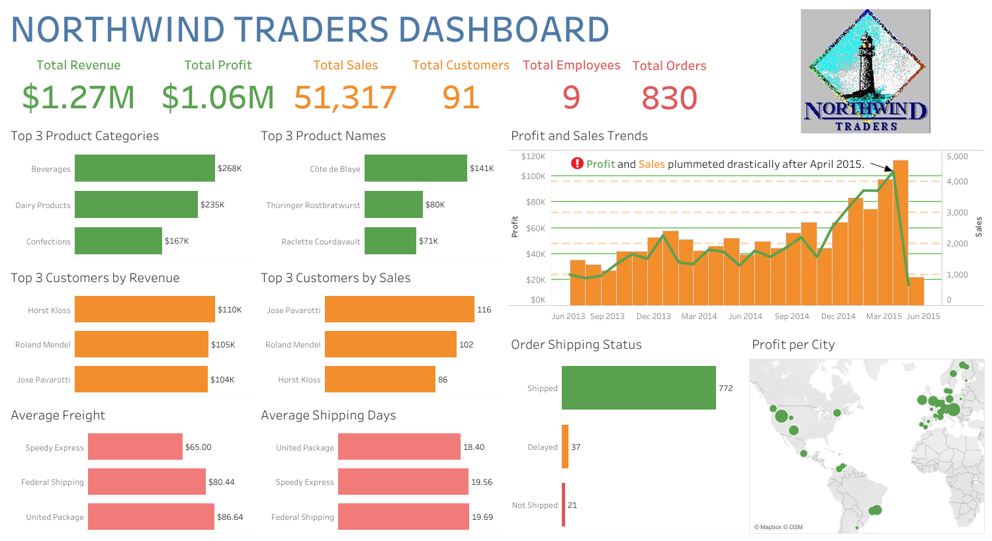

Slide 2
Abstract
I assumed the role of a BI Developer for Northwind Traders.
Northwind Traders is a fictitious gourmet food supplier.
I built a top-level KPI dashboard for the executive team.
The dashboard provides insights into these key areas of the business:
sales trends
product performance
key customers
shipping costs
I used Excel and Tableau for this project.
I cleaned the tables and built a relational data model in Excel.
I exported the cleaned tables to Tableau to conduct my analysis.

Slide 3
Data Cleaning Strategy
I am working with structured data.
The data consists of sales and order data.
Therefore, my data cleaning strategy was not very involved.
I changed the currency metrics to currency data types.
I made the following changes to the “products” table:
I changed the “1” values to “Yes” values in the “discontinued” column.
I changed the “0” values to “No” values in the “discontinued” column.
I assumed that the product prices remained fixed when the orders were placed.
My analysis did not factor in any supply and demand factors that might have caused any price fluctuations.
I assumed that orders that were delayed or not shipped had no shipping days.

Slide 4
Key Questions
Product Sales Analysis
What were the top 3 product categories and names in terms of revenue?
How have profit and sales changed over time?
Which areas of the world were the most profitable for the business?
Customer Analysis
Who were the top 3 most valuable customers in terms of revenue and sales?
How many orders have been shipped, delayed, or not shipped?
Shipping Analysis
Which shipper had the cheapest shipping cost on average?
Which shipper shipped out orders the earliest on average?

Slide 5
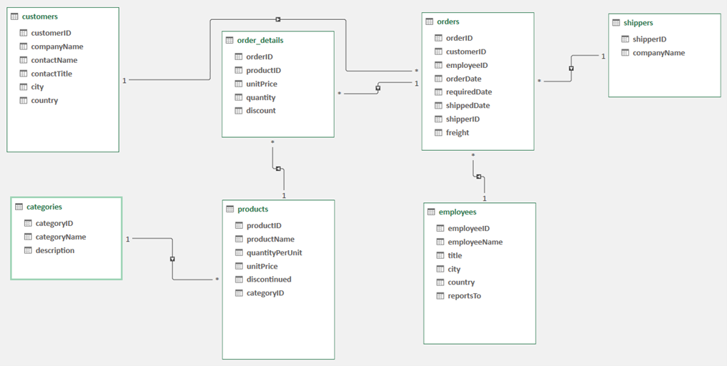
Data Model

Slide 6
Product Sales Insights
These product categories drove the most revenue for the business:
Beverages
Dairy Products
Confections
These product names drove the most revenue for the business:
Côte de Blaye
Thüringer Rostbratwurst
Raciette Courdavault
Profit and Sales saw a steep decline from April 2015 to May 2015.
Profit fell from a maximum of $104K in April to a minimum of $16K in May. (a staggering 84.61% drop)
Sales fell from a maximum of 4,680 in April to a minimum of 921 in May. (a staggering 80.32% drop)
Profits were heavily concentrated in European cities.
These European cities were driving the most profit:
Graz, Austria
London, UK
Cork, Ireland

Slide 7
Customer Insights
These were the most valuable customers for the business in terms of revenue and sales:
Horst Kloss
Roland Mendel
Jose Pavarotti
Most orders were shipped to customers at or before the requested delivery date.
There were only a handful of orders that were either delayed or not shipped.

Slide 8
Shipping Insights
Speedy Express had the cheapest shipping cost of $65.00 on average.
United Package shipped out orders the earliest at 18.40 days on average.

Slide 9
Recommendations
I recommend the following guidelines for recovering from the profit and sales losses:
Upsell on the top 3 product categories and names.
This will likely ensure that revenue and profit are maximized in the future.
Maintain great relationships with ALL customers, especially the top 3.
Maintain the high ratio of orders shipped to delayed and not shipped orders.
Hire more employees to meet the demands of customer orders.
This will likely minimize the number of orders that are delayed or not shipped.
Concentrate marketing campaigns in European cities.
This strategy will likely attract new customers because most of the profit came from these cities.

